Slide 1
GIS
A Geographic Information System
integrates hardware, software, and data
for capturing, managing, analyzing, and displaying all forms
of geographically referenced information.

Slide 2
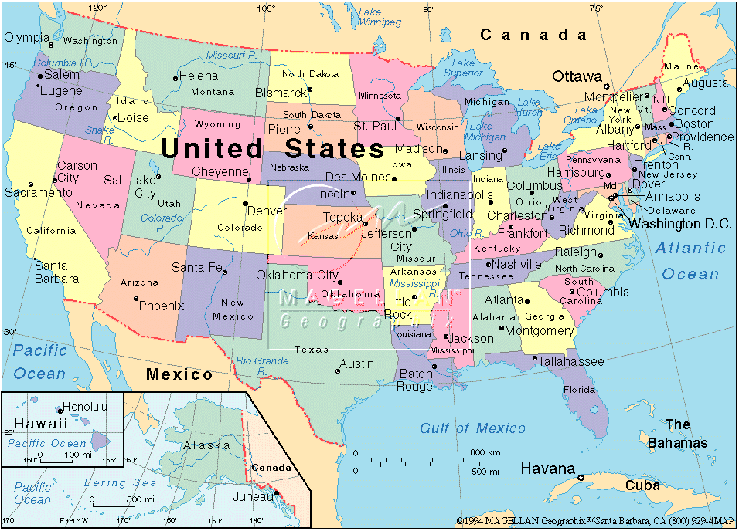
Basic maps like the United States for early learners,
showing political boundaries of states and their capitals.

Slide 3
Use colors on a map to define topography:
mountains, plains, water, snow peaks, deserts.

Slide 4
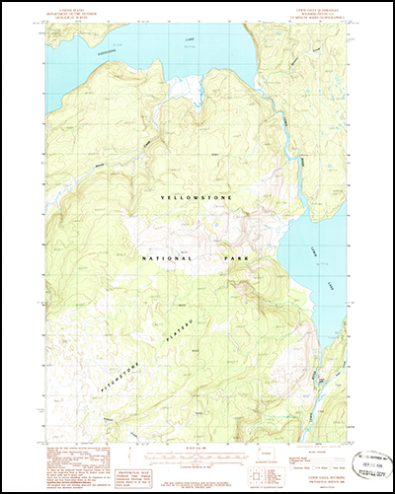
Add contour lines for greater definition & detail.

Slide 5
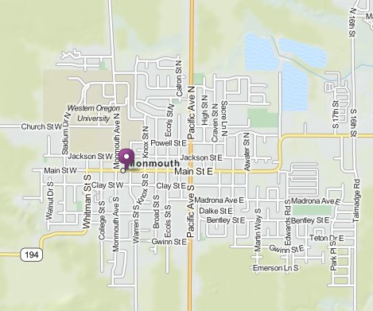
Maps for towns and cities

Slide 7
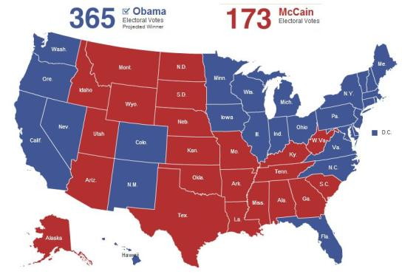
Maps with political information such as election results state by state

Slide 8
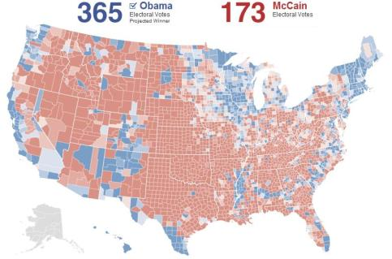
… or county by county

Slide 9
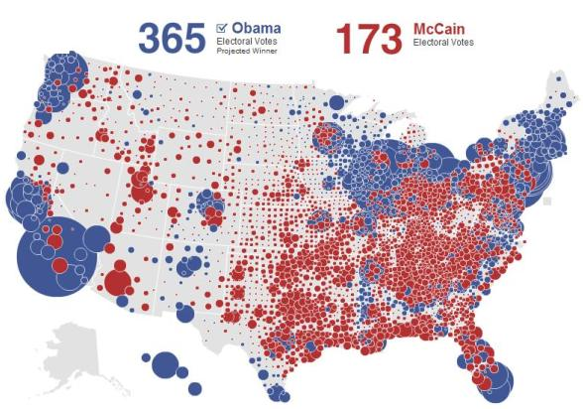
…or in such a way to represent population instead of area.

Slide 10
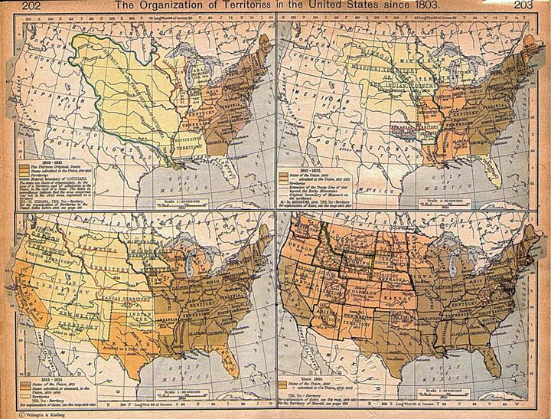
Maps to show changes throughout history.

Slide 11
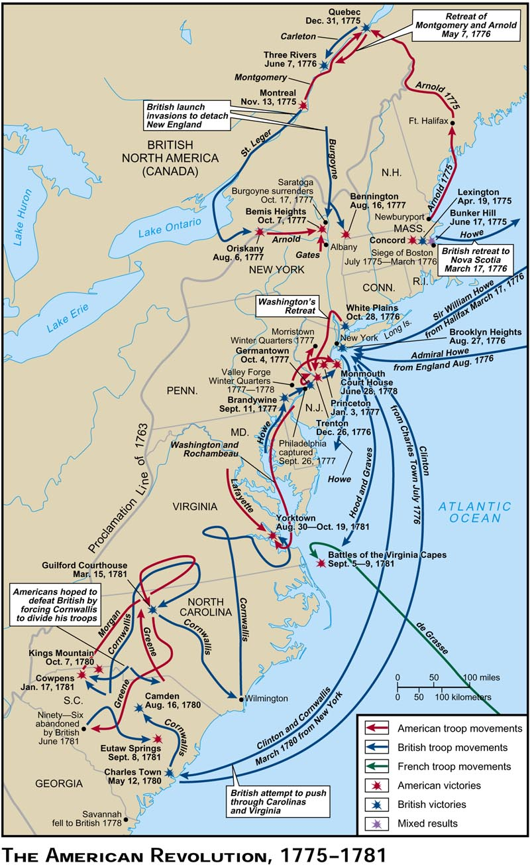
…or identify locations of historic events and their importance relative to each other.

Slide 12
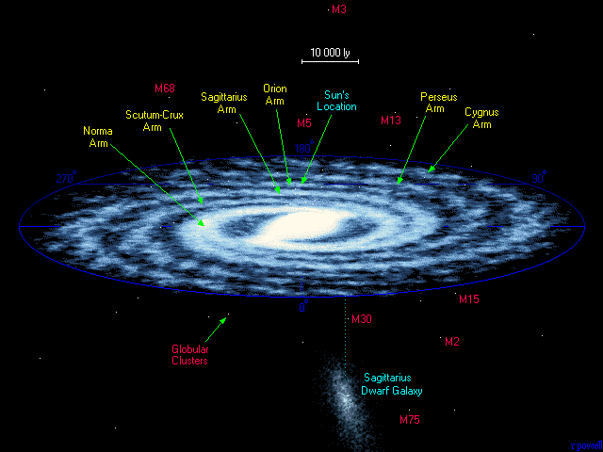
Maps to see things we can’t ordinarily see.

Slide 13
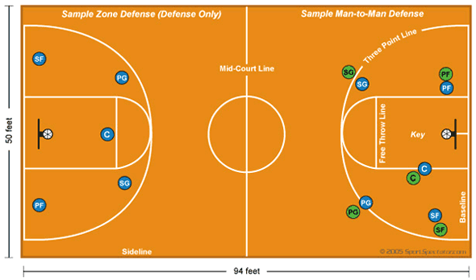
Maps as diagrams of game plans.

Slide 14
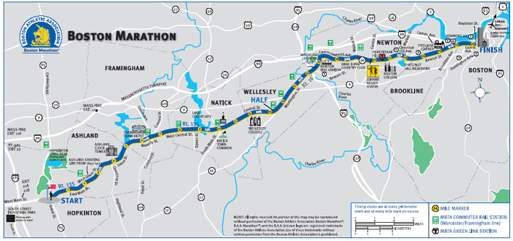
Maps to layout events or activities

Slide 15
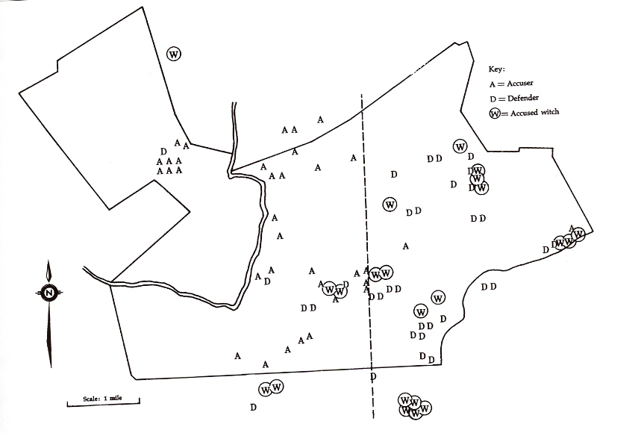
Maps to explain

Slide 16
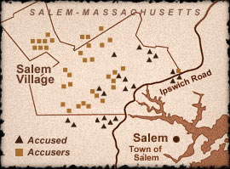
Another view of same setting

Slide 17
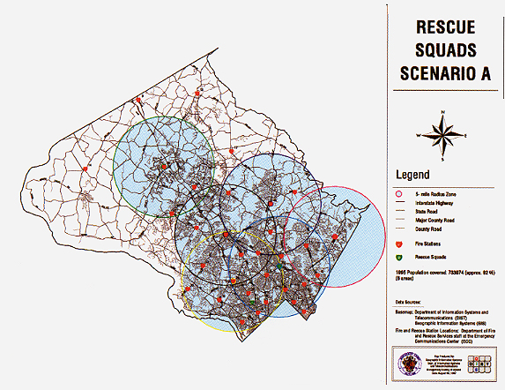
Maps help us plan
Notes:
By looking at overlapping circles which represent response times from a fire station one can determine the need for new stations and the redundancy of overlapping services

Slide 18
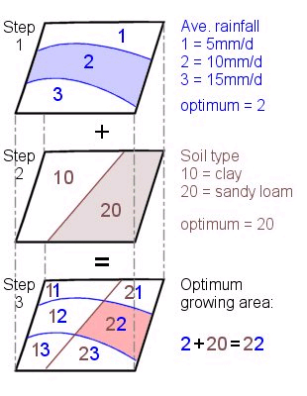
Overlaying maps help us to relate different features with one another
Notes:
By overlaying maps of rainfall and soil types one can locate optimum locations for certain crops or vegetation.

Slide 19
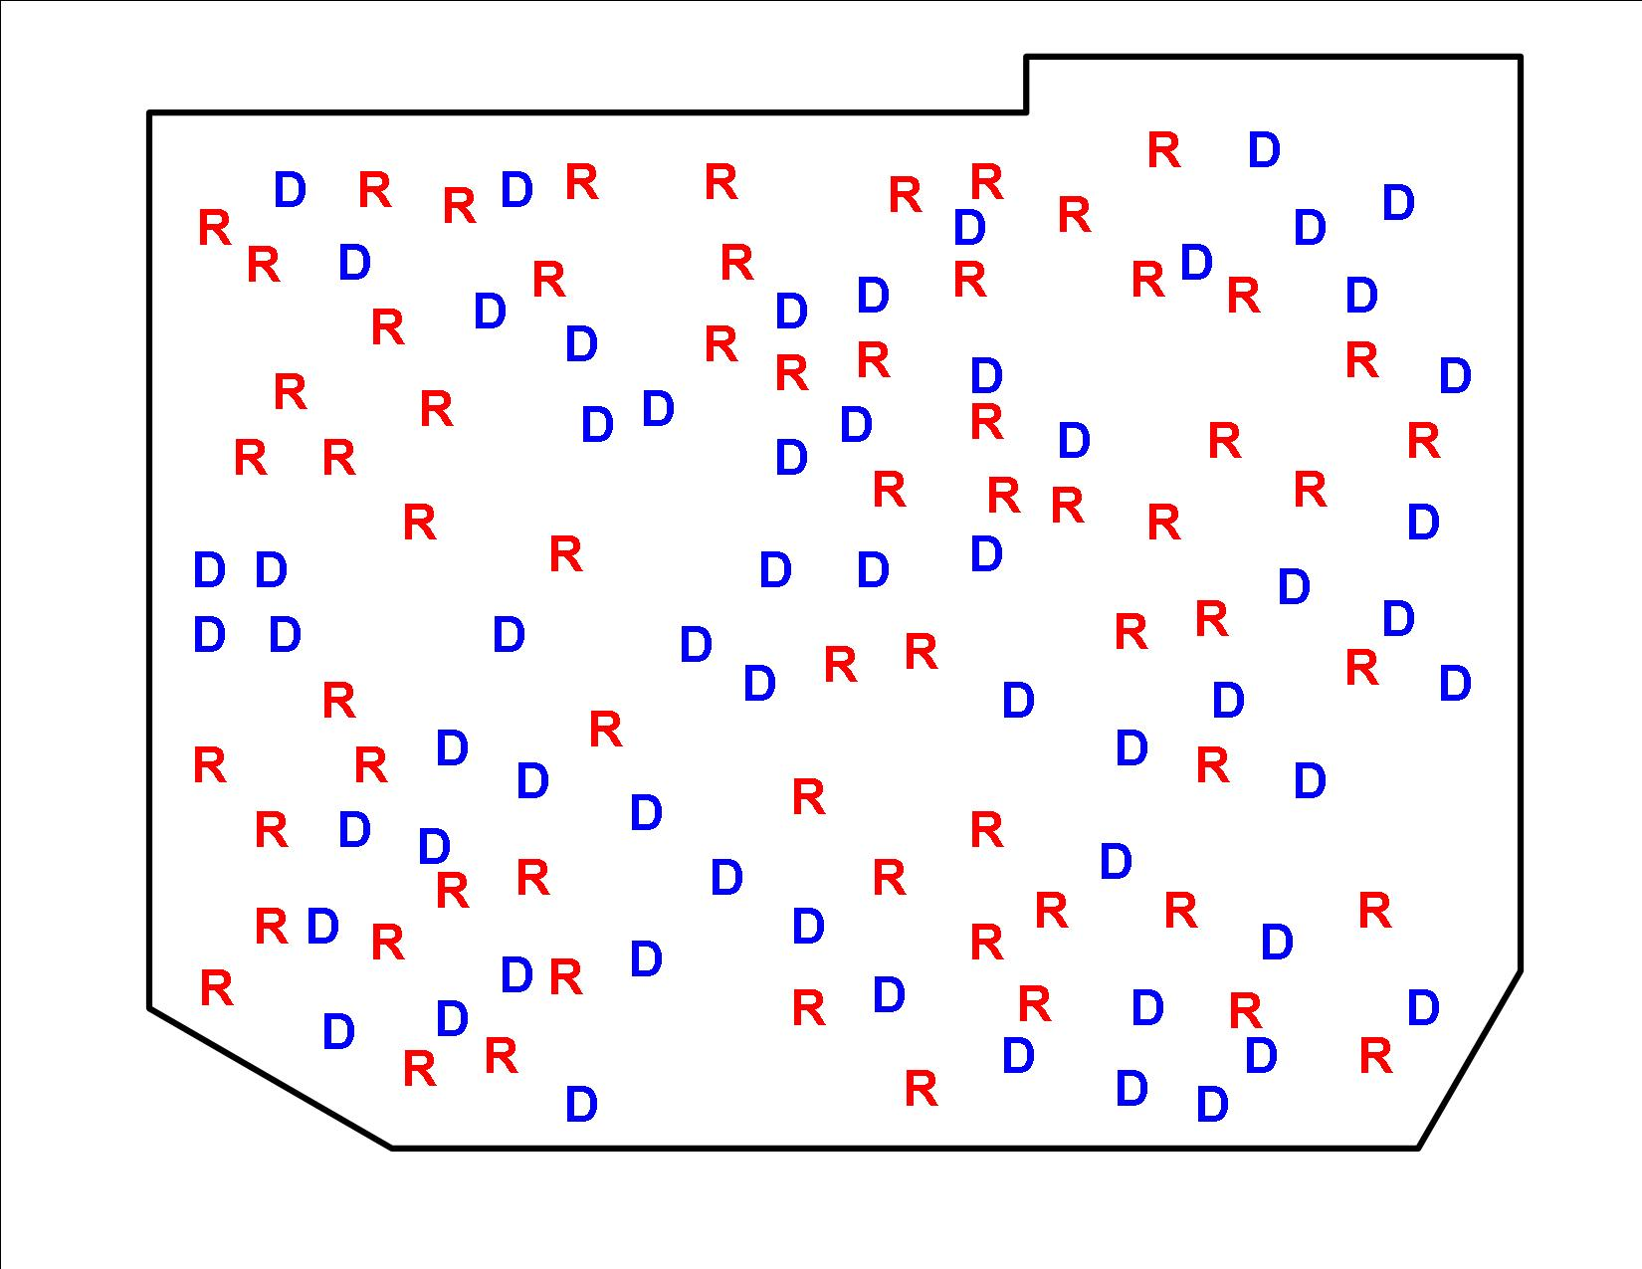
Distribution of R and D voters in a district
Notes:
Until the 1990s, legislators had to draw districts using coloured pens on acetate sheets spread out on big maps on the floor. Computers appeared in the 1990s, but only big, sophisticated ones could handle the demographic data, putting the cost beyond all but a few states.
Now the Census Bureau puts out digitised maps, called TIGER/Line files. New geographic information systems for mapping and analysing demographic data cost only a few thousand dollars, work on ordinary Windows operating systems, and can draw up partisan maps automatically. This has turned gerrymanderingósorry, redistrictingófrom an art into a science.
(because computers have made it easy to ensure that districts are overwhelmingly one party or the other – as opposed to close calls) redistricting is becoming a glorified incumbent-protection racket. And that is having all sorts of odd effects.

Slide 20
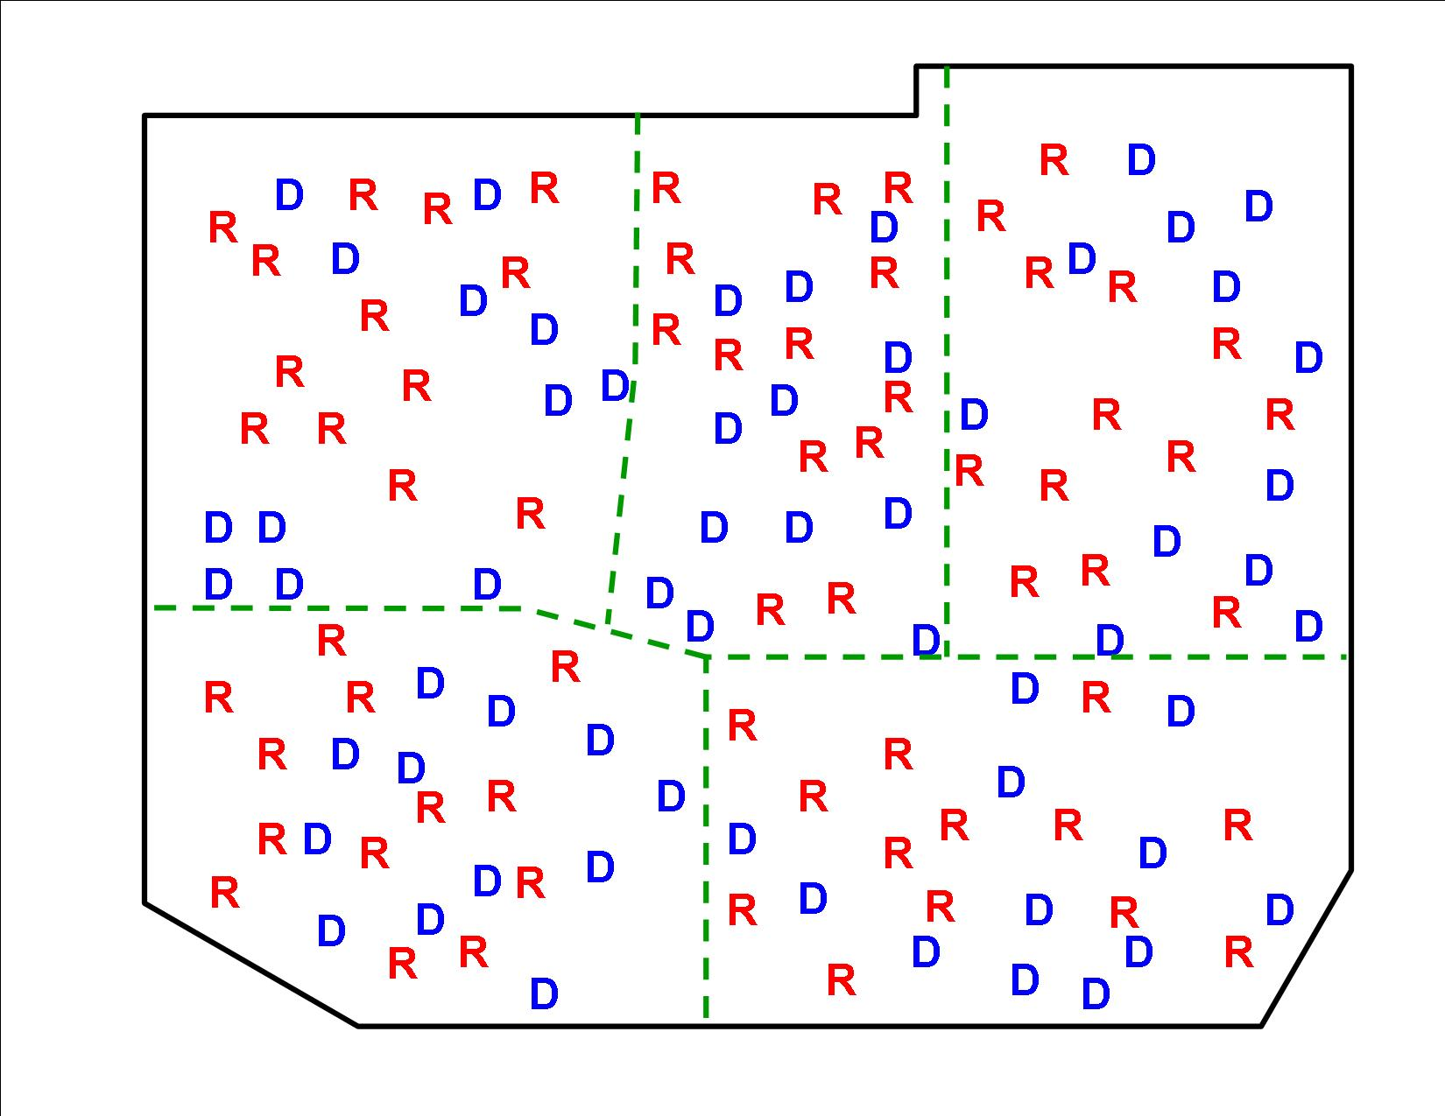
All five precincts have 13 R and 12 D.
Notes:
Upper left - R (12D, 13R), center – R (12D, 13R), upper right – R (12D, 13R)
Lower left - - R (12D, 13R), lower right – R (12D, 13R) ALL “R”

Slide 21
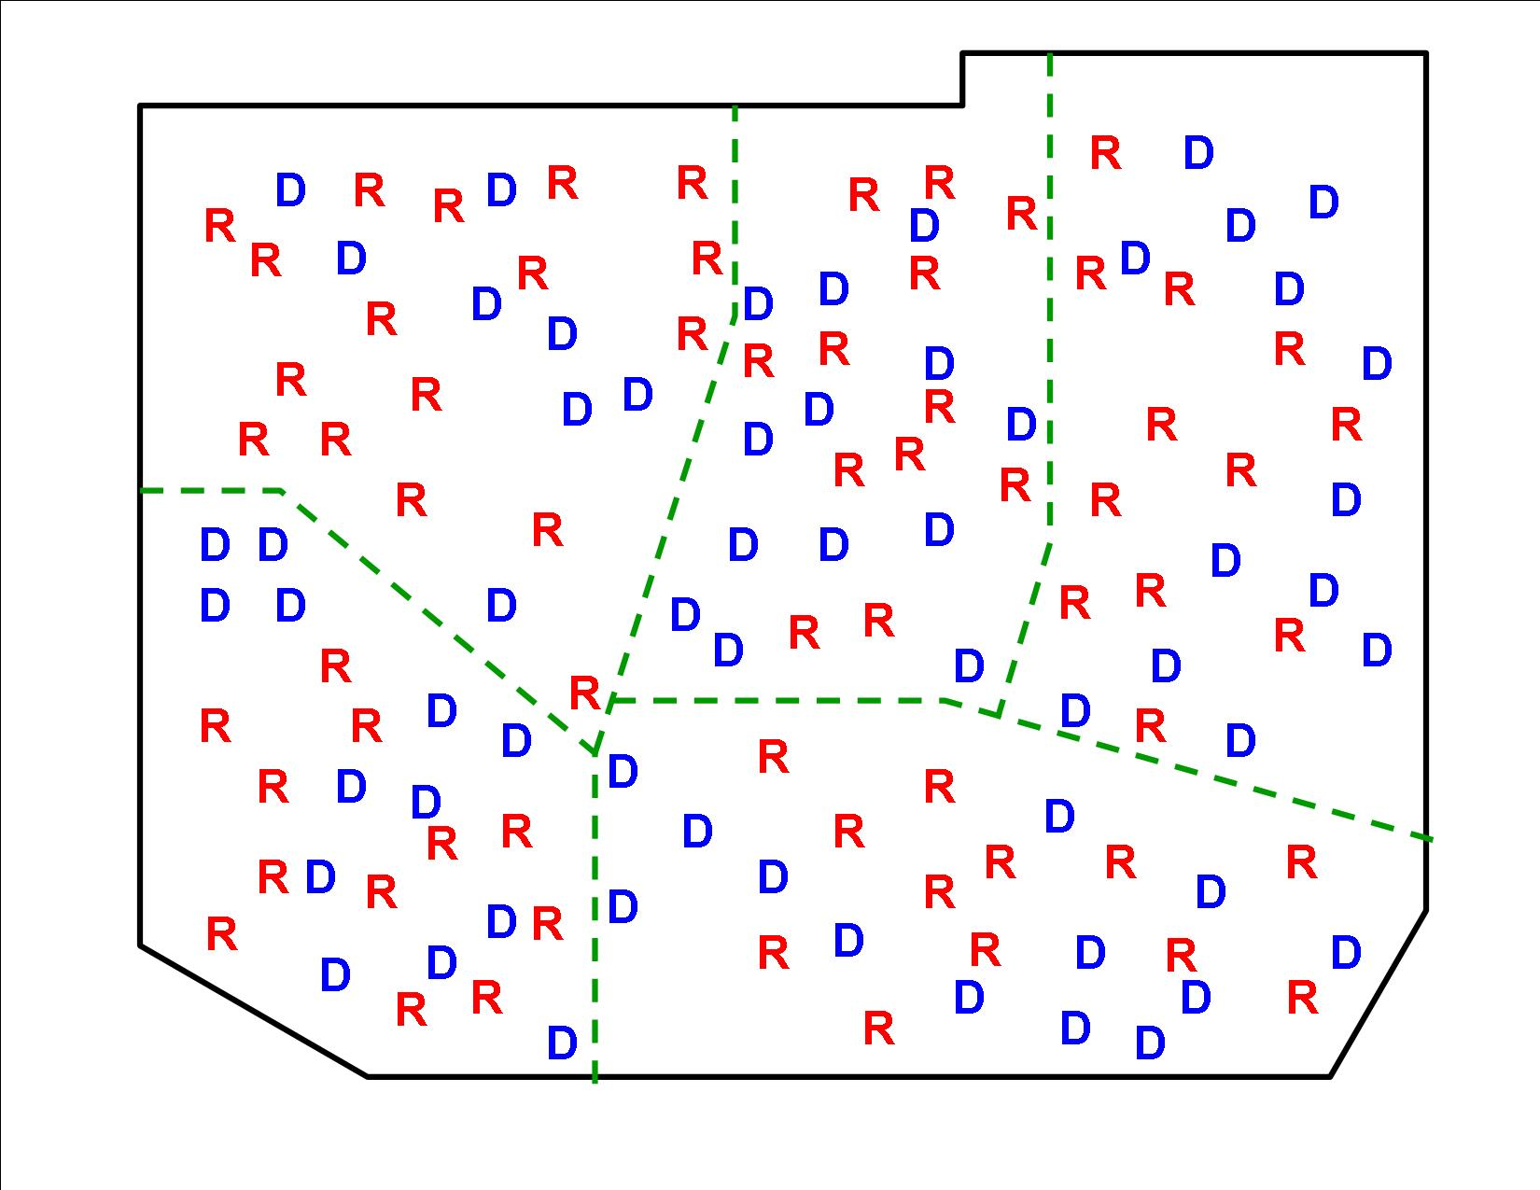
Upper left precinct has 8D and 16R, all others have 13D and 12R
Notes:
Upper left - R (8D, 16R), center – D (13D, 12R), upper right – D (13D, 12R)
Lower left - - D (13D, 12R), lower right – R (13D, 12R) Majority = “D”; only one “R” precinct

Slide 22
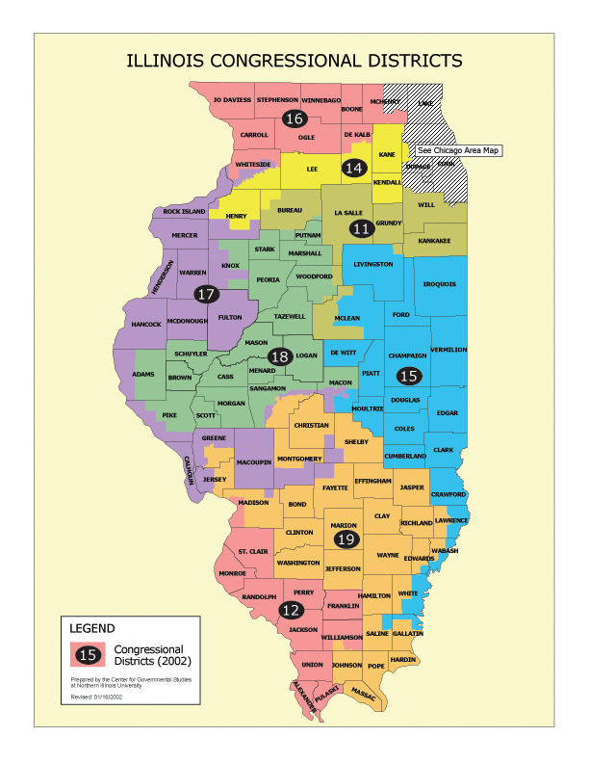
District 17 was created grabbing Democratic cities to assure that districts 18 and 19 were Republican.
Notes:
But the champion gerrymandering comes from Illinois. Chicago has two Hispanic areas. They are in different parts of the city, but that has not discouraged the good politicians of Illinois from creating a constituency consisting of these two areas only. They lie on either side of a black part of the city like the bread of a sandwich. Worst of all is the state's extraordinary 17th District, which is a crab (see chart). Though most of it lies in the western part of the state, two claws stretch out towards the eastern part to grab Democratic cities in order to make the surrounding 18th and 19th districts more reliably Republican.
Weirdly shaped districts like these are signs that a crime has been committed.
http://www.fairvote.org/op_eds/economistredis.htm
For more info, see: http://www.igpa.uiuc.edu/publications/pdf/Redistricting2001.pdf

Slide 23
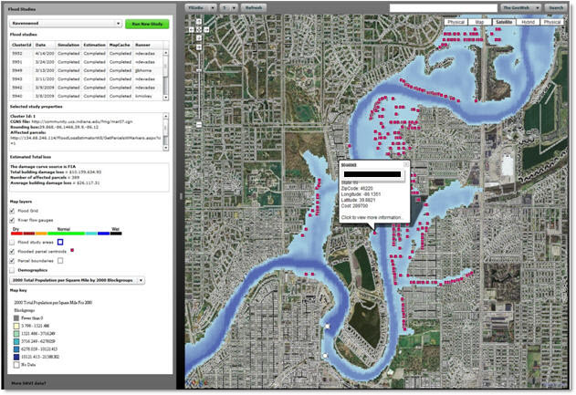
Maps help identify hazards such as flooding potential

Slide 24
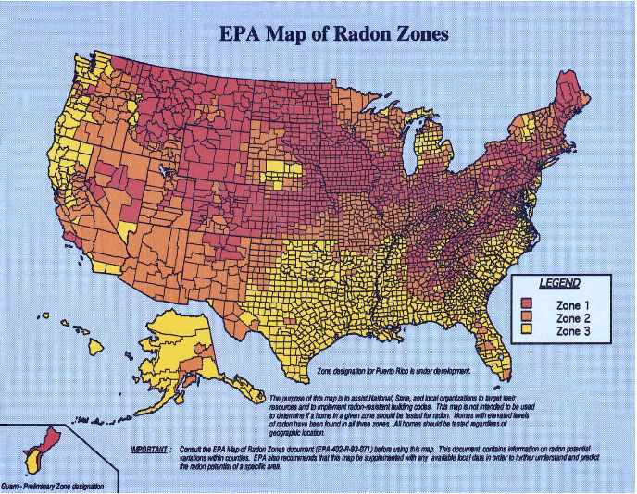
… or radon potential

Slide 25
Map of the Settings of Shakespeare’s Plays
Yet to be created and uploaded onto the Internet

Slide 28
Mapping programs such as GoogleEarth allow us to create our own presentations

